Slide 1
CSC 716 Final Project Presentation
Project 3

Slide 2
Project Goal
Implement and evaluate three real time jobs scheduling algorithms:
Deadline Monotonic, Rate Monotonic, and Earliest Deadline First
The presentation is structured as follows:
Explain the three algorithms
Explain input file format
Explain sim file and possible options
Overview of implementation
Results and Analysis of two examples

Slide 3
Rate Monotonic Scheduling algorithm
The Rate monotonic scheduling algorithm is a real time operating system algorithm
It is a priority algorithm where the priority of the process is 1/period.
It is a preemptive algorithm where each time a process comes into the queue, the higher priority process is executed
Rate-Monotonic scheduling algorithm is considered optimal
CPU utilization is bounded, and it is not always possible to fully maximize CPU resources.

Slide 4
Rate Monotonic Scheduling Implementation
RM Scheduling Algorithm assigns a priority to a process therefore we used a priority queue to implement the algorithm.
A struct was used to save information of the processes including:
processID
Arrival_time
Period
Deadline
Upcoming_deadline
Upcoming_period
Execution_time, and
remaining_execution_time
The < operator was also overloaded to return the largest (1/period) of the processes
Priority variable => 1/p1 > 1/p2 > 1/p3 > 1/p4 > 1/p5 > …
Execution Times
Deadline
Period
State variable of each process to indicate whether the process is executed in the current period or not

Slide 5
Deadline Monotonic Scheduling algorithm
Works for periodic/aperiodic tasks
Has a fixed priority
The shorter the relative deadline the higher the priority
RM and DM are identical if the relative deadline is proportional to its period
In other cases, DM performs better than RM
Priority variable => d1 < d2 < d3 < d4 < d5 < …
Execution Times
Deadline
Period
State variable of each process to indicate whether the process is executed in the current period or not

Slide 6
Deadline Monotonic Scheduling Implementation
DM Scheduling Algorithm assigns a priority to a process therefore we used a priority queue to implement the algorithm.
As with RM Scheduling Algorithm, a struct was used to save information of the processes including:
processID
Arrival_time
Period
Deadline
Upcoming_deadline
Upcoming_period
Execution_time, and
remaining_execution_time
The < operator was also overloaded to return the smallest relative deadline of the processes
Priority variable => d1 < d2 < d3 < d4 < d5 < …

Slide 7


Earliest-Deadline-First Scheduling algorithm
Earliest Deadline First Scheduling algorithm dynamically assigns priorities according to the deadline of a process
The earlier the deadline of a process, the higher the priority of that process
Must satisfy Feasibility Test
Necessary Condition:
Sufficient Condition:
To test feasibility construct a schedule from 0 to some time T → if all deadlines met and certain conditions satisfied.

Slide 8
Earliest Deadline First Scheduling Implementation
EDF Scheduling Algorithm assigns a priority to a process therefore we used a priority queue to implement the algorithm.
As with RM Scheduling Algorithm, a struct was used to save information of the processes including:
processID
Arrival_time
Period
Deadline
Upcoming_deadline – corresponds to which process’s deadline is next
Upcoming_period
Execution_time, and
remaining_execution_time
The < operator was also overloaded to return the smallest upcoming deadline of the processes

Slide 9




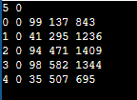

Input File
Constraint 1: At least 5 processes
For each process:
Constraint 2: You can assume all the processes arrive at different time and assume the arrival interval of the processes is exponential distribution with the mean of 20 time units.
Mean: lambda
Constraint 3: For each process, the average of CPU burst should be uniformly distributed on 30 to 100 time units
rand()%70 => 0 and 70
We add 30 to it => between 30 to 100.
Constraint 4: The deadline of each process should be greater than its CPU burst, you can get the deadline by adding the process's CPU burst and a number x, and x is uniformly distributed on 0 to 500; rand()%500 => 0 and 500
Constraint 5: The period of each process should be greater than its relative deadline, you can get the period by adding the process's relative deadline and a number y, and y is uniformly distributed on 0 to 1000. rand()%1000 => 0 and 1000

Slide 10
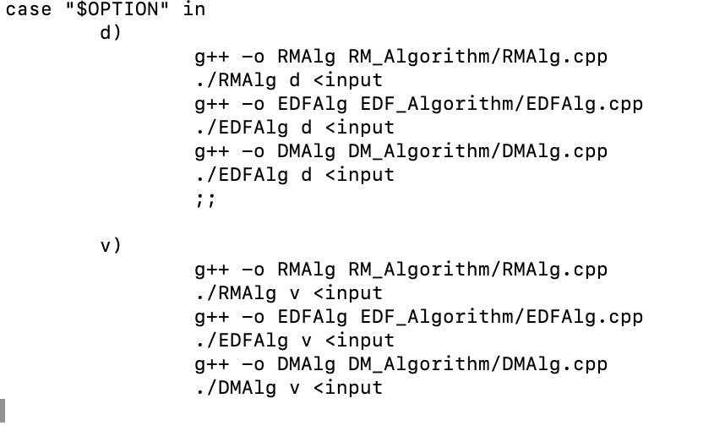
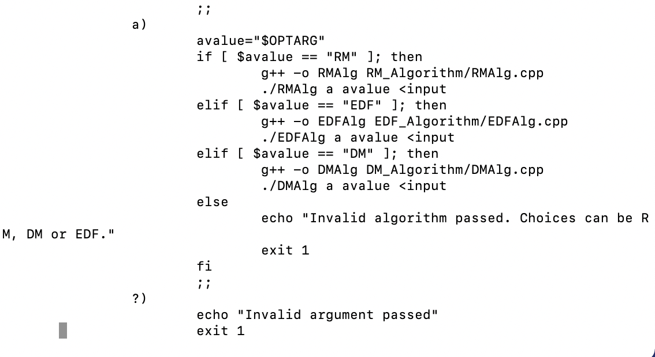
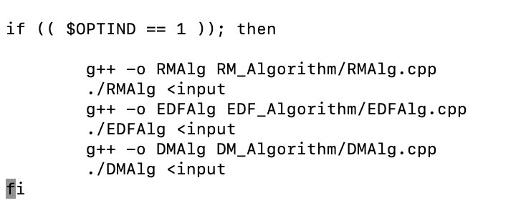
Simulation File and Possible Flags
We wrote a bash script titled sim so all programs can run together and flags can be passed.
No flag means default output.
-a means algorithm specific output
-v means verbose mode where details of scheduling and preemption are provided
-d means detailed where each processes’ details including finish times are provided

Slide 11
Bool isFeasible=true;
Int end_of_sim=lcm(period_i);
Priority_queue pq;
Double idle_time;
Double time;
Time=arrival of first process;
Push processes that arrived into pq;
While (isFeasible && time<end_of_sim){
}
Simplified PseudoCode
If pq is empty{
Find smallest of upcoming periods (It will pre-empt first)
Add associated process into queue
Update time
Update Idle time
}
Else{
Get process with highest priority from pq
Get time of next process to preempt (smallest of upcoming periods)
Find time of current process completion (Check whether process has
remaining time and didn’t finish executing yet)
Check if time of current process completion is less than or equal to
process deadline (if not, change isFeasible to false and continue to
next iteration of while which will stop loop)
Case 1: If time of current process completion< next process to preempt time:
Current Process finished executing
Update time
Case 2: If time of current process completion== next process to preempt time:
Current Process finished executing
Update time
Add next process to preempt to pq
Case 3: If time of current process completion> next process to preempt time:
Current Process did not finish executing
Update remaining time of execution for current process
Add next process to preempt to pq
Update time
RM
If pq is empty{
Find smallest of upcoming deadlines
Add associated process into queue
Update time
Update Idle time
}
Else{
Get process with smallest deadline from pq
Get time of next process to preempt with next smallest deadline
Find time of current process completion (Check whether process has
remaining time and didn’t finish executing yet)
Check if time of current process completion is less than or equal to
process deadline (if not, change isFeasible to false and continue to
next iteration of while which will stop loop)
Case 1: If time of current process completion< next process to preempt time:
Current Process finished executing
Update time
Case 2: If time of current process completion== next process to preempt time:
Current Process finished executing
Update time
Add next process to preempt to pq
Case 3: If time of current process completion> next process to preempt time:
Current Process did not finish executing
Update remaining time of execution for current process
Add next process to preempt to pq
Update time
EDF
DM
If pq is empty{
Find smallest of upcoming periods (It will pre-empt first)
Add associated process into queue
Update time
Update Idle time
}
Else{
Get process with highest priority from pq
Get time of next process to preempt (smallest of upcoming periods)
Find time of current process completion (Check whether process has
remaining time and didn’t finish executing yet)
Check if time of current process completion is less than or equal to
process deadline (if not, change isFeasible to false and continue to
next iteration of while which will stop loop)
Case 1: If time of current process completion< next process to preempt time:
Current Process finished executing
Update time
Case 2: If time of current process completion== next process to preempt time:
Current Process finished executing
Update time
Add next process to preempt to pq
Case 3: If time of current process completion> next process to preempt time:
Current Process did not finish executing
Update remaining time of execution for current process
Add next process to preempt to pq
Update time

Slide 12
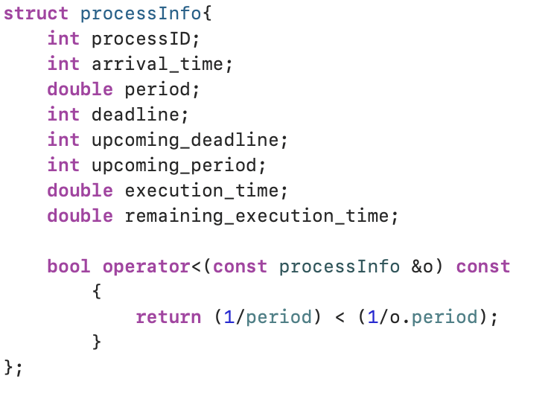
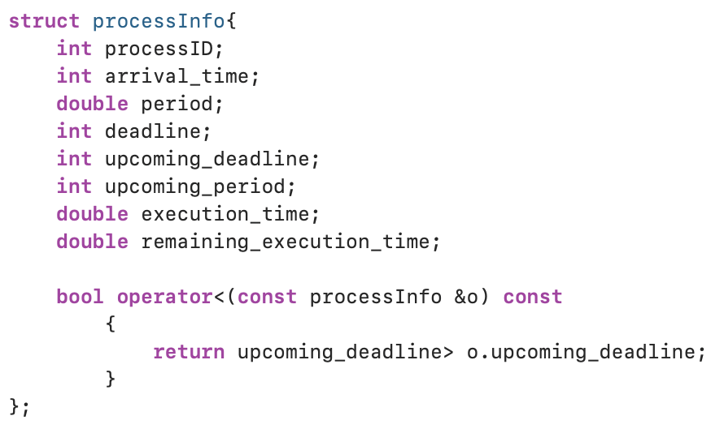
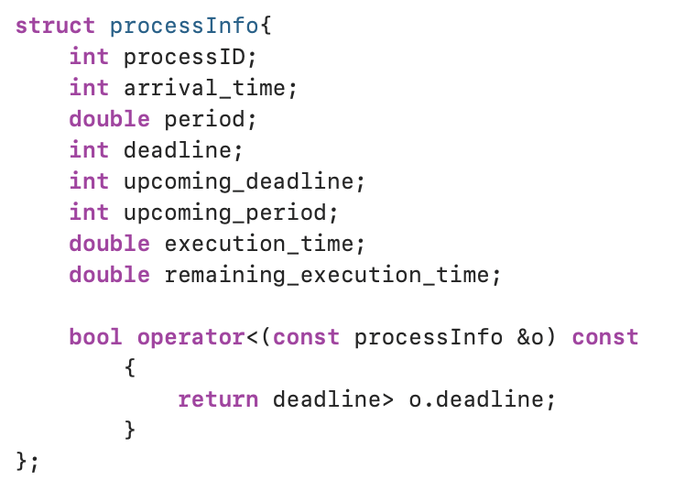
Algorithm Details
Each algorithm holds all process information in a data structure and deciding what data structure would be used to represent our queue
A struct is created holding all the processes information
A priority queue is implemented to add processes to the queue
The < operator is overloaded to ensure that processes added into the queue were done so in a way that considered their priority for each algorithm
RM
EDF
DM

Slide 13
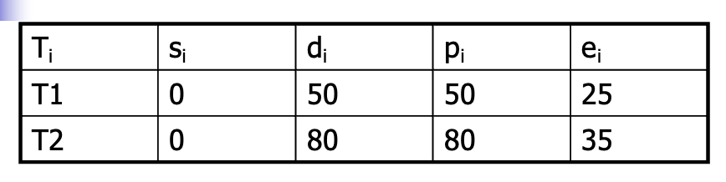
Results with lecture example
We will first show the results for the class example using our code

Slide 14
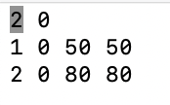
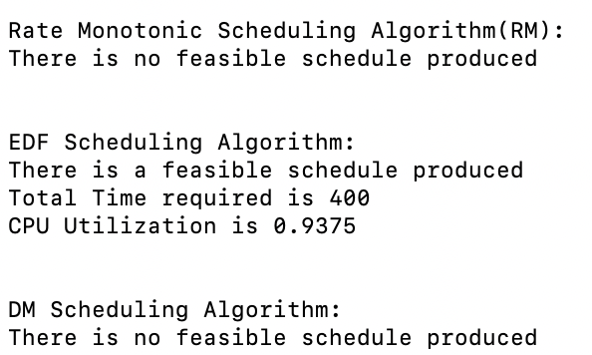
Class example
Results of Simulation when arrival_time = 0 and process_switch = 0
./sim -v <input
EDF Scheduling Algorithm:
At time: 0, process 1 is scheduled until 25
At time: 25, process 2 is scheduled until 50
At time: 50, process 2 is preempted by process 2
At time: 50, process 2 is scheduled until 60
At time: 60, process 1 is scheduled until 80
At time: 80, process 1 is preempted by process 1
At time: 80, process 1 is scheduled until 85
At time: 85, process 2 is scheduled until 100
At time: 100, process 2 is preempted by process 2
At time: 100, process 2 is scheduled until 120
At time: 120, process 1 is scheduled until 145
At time: 150, process 1 is scheduled until 160
At time: 160, process 1 is preempted by process 1
At time: 160, process 1 is scheduled until 175
At time: 175, process 2 is scheduled until 200
At time: 200, process 2 is preempted by process 2
At time: 200, process 2 is scheduled until 210
At time: 210, process 1 is scheduled until 235
At time: 240, process 2 is scheduled until 250
At time: 250, process 2 is preempted by process 2
At time: 250, process 2 is scheduled until 275
At time: 275, process 1 is scheduled until 300
At time: 300, process 1 is scheduled until 320
At time: 320, process 1 is preempted by process 1
At time: 320, process 1 is scheduled until 325
At time: 325, process 2 is scheduled until 350
At time: 350, process 2 is preempted by process 2
At time: 350, process 2 is scheduled until 360
At time: 360, process 1 is scheduled until 385
Rate Monotonic Scheduling Algorithm(RM):
At time: 0, process 1 is scheduled until 25
At time: 25, process 2 is scheduled until 50
At time: 50, process 2 is preempted by process 1
At time: 50, process 1 is scheduled until 75
Input:
DM Scheduling Algorithm:
At time: 0, process 1 is scheduled until 25
At time: 25, process 2 is scheduled until 50
At time: 50, process 2 is preempted by process 1
At time: 50, process 1 is scheduled until 75
./sim <input
Analysis:
The RM and DM algorithms did not give a feasible schedule
The EDF Algorithm was able to produce a feasible schedule with a CPU Utilization of 93%
DM and RM gave same scheduling, as expected since deadline is proportional to period

Slide 15

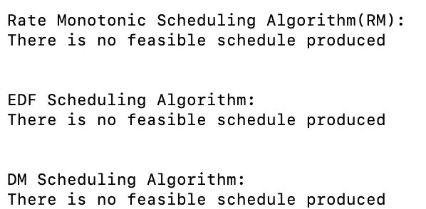
Class example
Results of Simulation when arrival_time = 0 and process_switch = 5
./sim -v <input
Input:
Rate Monotonic Scheduling Algorithm(RM):
At time: 0, process 1 is scheduled until 25
At time: 30, process 2 is scheduled until 55
At time: 55, process 2 is preempted by process 1
At time: 55, process 1 is scheduled until 80
EDF Scheduling Algorithm:
At time: 0, process 1 is scheduled until 25
At time: 30, process 2 is scheduled until 55
At time: 55, process 2 is preempted by process 2
At time: 55, process 2 is scheduled until 70
At time: 75, process 1 is scheduled until 85
At time: 85, process 1 is preempted by process 1
At time: 85, process 1 is scheduled until 105
At time: 105, process 1 is preempted by process 1
At time: 105, process 1 is scheduled until 110
At time: 115, process 1 is scheduled until 140
At time: 145, process 2 is scheduled until 155
At time: 155, process 2 is preempted by process 2
DM Scheduling Algorithm:
At time: 0, process 1 is scheduled until 25
At time: 30, process 2 is scheduled until 55
At time: 55, process 2 is preempted by process 1
At time: 55, process 1 is scheduled until 80
Analysis:
None of the algorithms produced a feasible schedule when process switch is 5
EDF was able to schedule the most processes but eventually process 2 missed a deadline
./sim <input

Slide 16
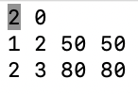
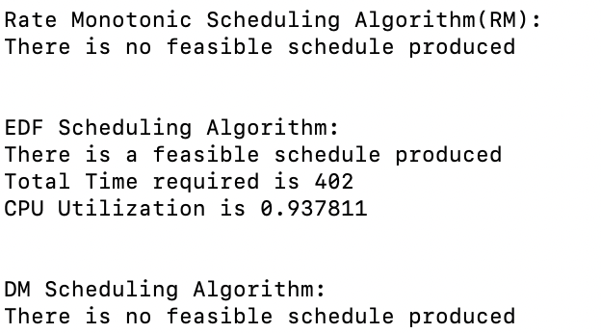
Class example
Results of Simulation when arrival_time = 2, 3 and process_switch = 0
Input:
./sim -v <input
EDF Scheduling Algorithm:
At time: 2, process 1 is scheduled until 3
At time: 3, process 1 is preempted by process 1
At time: 3, process 1 is scheduled until 27
At time: 27, process 2 is scheduled until 52
At time: 52, process 2 is preempted by process 2
At time: 52, process 2 is scheduled until 62
At time: 62, process 1 is scheduled until 83
At time: 83, process 1 is preempted by process 1
At time: 83, process 1 is scheduled until 87
At time: 87, process 2 is scheduled until 102
At time: 102, process 2 is preempted by process 2
At time: 102, process 2 is scheduled until 122
At time: 122, process 1 is scheduled until 147
At time: 152, process 1 is scheduled until 163
At time: 163, process 1 is preempted by process 1
At time: 163, process 1 is scheduled until 177
At time: 177, process 2 is scheduled until 202
At time: 202, process 2 is preempted by process 2
At time: 202, process 2 is scheduled until 212
At time: 212, process 1 is scheduled until 237
At time: 243, process 2 is scheduled until 252
At time: 252, process 2 is preempted by process 2
At time: 252, process 2 is scheduled until 278
At time: 278, process 1 is scheduled until 302
At time: 302, process 1 is preempted by process 1
At time: 302, process 1 is scheduled until 303
At time: 303, process 1 is scheduled until 323
At time: 323, process 1 is preempted by process 1
At time: 323, process 1 is scheduled until 328
At time: 328, process 2 is scheduled until 352
At time: 352, process 2 is preempted by process 2
At time: 352, process 2 is scheduled until 363
At time: 363, process 1 is scheduled until 388
Rate Monotonic Scheduling Algorithm(RM):
At time: 2, process 1 is scheduled until 3
At time: 3, process 1 is preempted by process 1
At time: 3, process 1 is scheduled until 27
At time: 27, process 2 is scheduled until 52
At time: 52, process 2 is preempted by process 1
At time: 52, process 1 is scheduled until 77
At time: 77, process 2 is scheduled until 83
At time: 83, process 2 is preempted by process 2
At time: 83, process 2 is scheduled until 102
At time: 102, process 2 is preempted by process 1
At time: 102, process 1 is scheduled until 127
Analysis:
Once again, EDF was the only one that produced a feasible schedule
CPU Utilization stayed about the same
It took EDF a bit longer to finish since arrival times increased
./sim <input
DM Scheduling Algorithm:
At time: 2, process 1 is scheduled until 3
At time: 3, process 1 is preempted by process 1
At time: 3, process 1 is scheduled until 27
At time: 27, process 2 is scheduled until 52
At time: 52, process 2 is preempted by process 1
At time: 52, process 1 is scheduled until 77
At time: 77, process 2 is scheduled until 83
At time: 83, process 2 is preempted by process 2
At time: 83, process 2 is scheduled until 102
At time: 102, process 2 is preempted by process 1
At time: 102, process 1 is scheduled until 127

Slide 17
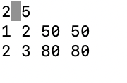
Class example
Results of Simulation when arrival_time = 2,3 and process_switch = 5
./sim -v <input
Input:
Rate Monotonic Scheduling Algorithm(RM):
At time: 2, process 1 is scheduled until 8
At time: 8, process 1 is preempted by process 1
At time: 8, process 1 is scheduled until 32
At time: 37, process 2 is scheduled until 57
At time: 57, process 2 is preempted by process 1
At time: 57, process 1 is scheduled until 82
At time: 87, process 2 is scheduled until 88
At time: 88, process 2 is preempted by process 2
At time: 88, process 2 is scheduled until 107
At time: 107, process 2 is preempted by process 1
At time: 107, process 1 is scheduled until 132
DM Scheduling Algorithm:
At time: 2, process 1 is scheduled until 8
At time: 8, process 1 is preempted by process 1
At time: 8, process 1 is scheduled until 32
At time: 37, process 2 is scheduled until 57
At time: 57, process 2 is preempted by process 1
At time: 57, process 1 is scheduled until 82
At time: 87, process 2 is scheduled until 88
At time: 88, process 2 is preempted by process 2
At time: 88, process 2 is scheduled until 107
At time: 107, process 2 is preempted by process 1
At time: 107, process 1 is scheduled until 132
./sim <input
EDF Scheduling Algorithm:
At time: 2, process 1 is scheduled until 8
At time: 8, process 1 is preempted by process 1
At time: 8, process 1 is scheduled until 32
At time: 37, process 2 is scheduled until 57
At time: 57, process 2 is preempted by process 2
At time: 57, process 2 is scheduled until 77
At time: 82, process 1 is scheduled until 88
At time: 88, process 1 is preempted by process 1
At time: 88, process 1 is scheduled until 107
At time: 107, process 1 is preempted by process 1
At time: 107, process 1 is scheduled until 117
At time: 122, process 1 is scheduled until 147
At time: 152, process 2 is scheduled until 157
At time: 157, process 2 is preempted by process 2
Rate Monotonic Scheduling Algorithm(RM):
There is no feasible schedule produced
EDF Scheduling Algorithm:
There is no feasible schedule produced
DM Scheduling Algorithm:
There is no feasible schedule produced
Analysis:
None of the processes gave a feasible schedule
The one that ran the longest is EDF once again

Slide 18
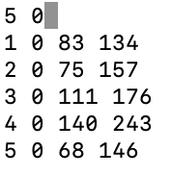
Results with input constraints from project
The results with the input file did not produce feasible algorithms, but we will display the results and discuss which algorithm gave the best results in terms of scheduling the most processes
P1: s1=33
P2: s2=35
P3: s3=40
P4: s4=50
P5: s5=42

Slide 19
Results of Simulation when arrival times all equal 0 and process_switch=0
Input:
Note: Program also produces -d detailed output, but we will show the -v and -a output here due to space limits
Rate Monotonic Scheduling Algorithm(RM):
At time: 0, process 1 is scheduled until 33
EDF Scheduling Algorithm:
At time: 0, process 5 is scheduled until 42
DM Scheduling Algorithm:
At time: 0, process 5 is scheduled until 42
Rate Monotonic Scheduling Algorithm(RM):
There is no feasible schedule produced
EDF Scheduling Algorithm:
There is no feasible schedule produced
DM Scheduling Algorithm:
There is no feasible schedule produced
Analysis:
No feasible schedule is produced by any algorithms

Slide 20
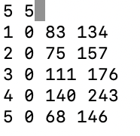
Results of Simulation when arrival times all equal 0 and process_switch=5
Input:
Note: Program also produces -d detailed output, but we will show the -v and -a output here due to space limits
Rate Monotonic Scheduling Algorithm(RM):
At time: 0, process 1 is scheduled until 33
EDF Scheduling Algorithm:
At time: 0, process 5 is scheduled until 42
DM Scheduling Algorithm:
At time: 0, process 5 is scheduled until 42
Rate Monotonic Scheduling Algorithm(RM):
There is no feasible schedule produced
EDF Scheduling Algorithm:
There is no feasible schedule produced
DM Scheduling Algorithm:
There is no feasible schedule produced
Analysis:
No feasible schedule is produced by any algorithms

Slide 21
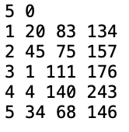
Results of Simulation when arrival times are different and process_switch=0
Input:
Note: Program also produces -d detailed output, but we will show the -v and -a output here due to space limits
EDF Scheduling Algorithm:
At time: 1, process 3 is scheduled until 4
At time: 4, process 3 is preempted by process 3
At time: 4, process 3 is scheduled until 20
At time: 20, process 3 is preempted by process 3
At time: 20, process 3 is scheduled until 34
At time: 34, process 3 is preempted by process 5
At time: 34, process 5 is scheduled until 45
At time: 45, process 5 is preempted by process 5
At time: 45, process 5 is scheduled until 76
At time: 76, process 3 is scheduled until 83
At time: 83, process 1 is scheduled until 116
At time: 116, process 2 is scheduled until 151
Rate Monotonic Scheduling Algorithm(RM):
At time: 1, process 3 is scheduled until 4
At time: 4, process 3 is preempted by process 3
At time: 4, process 3 is scheduled until 20
At time: 20, process 3 is preempted by process 1
At time: 20, process 1 is scheduled until 34
At time: 34, process 1 is preempted by process 1
At time: 34, process 1 is scheduled until 45
At time: 45, process 1 is preempted by process 1
At time: 45, process 1 is scheduled until 53
At time: 53, process 5 is scheduled until 95
DM Scheduling Algorithm:
At time: 1, process 3 is scheduled until 4
At time: 4, process 3 is preempted by process 3
At time: 4, process 3 is scheduled until 20
At time: 20, process 3 is preempted by process 1
At time: 20, process 1 is scheduled until 34
At time: 34, process 1 is preempted by process 5
At time: 34, process 5 is scheduled until 45
At time: 45, process 5 is preempted by process 5
At time: 45, process 5 is scheduled until 76
At time: 76, process 2 is scheduled until 111
Rate Monotonic Scheduling Algorithm(RM):
There is no feasible schedule produced
EDF Scheduling Algorithm:
There is no feasible schedule produced
DM Scheduling Algorithm:
There is no feasible schedule produced
Analysis:
No feasible schedule is produced by any algorithms
EDF ran the longest and scheduled more processes

Slide 22
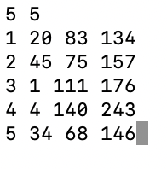
Results of Simulation when arrival times are different and process_switch=5
Input:
Note: Program also produces -d detailed output, but we will show the -v and -a output here due to space limits
DM Scheduling Algorithm:
At time: 1, process 3 is scheduled until 9
At time: 9, process 3 is preempted by process 3
At time: 9, process 3 is scheduled until 25
At time: 25, process 3 is preempted by process 1
At time: 25, process 1 is scheduled until 39
At time: 39, process 1 is preempted by process 5
At time: 39, process 5 is scheduled until 50
At time: 50, process 5 is preempted by process 5
At time: 50, process 5 is scheduled until 86
At time: 91, process 2 is scheduled until 126
Rate Monotonic Scheduling Algorithm(RM):
At time: 1, process 3 is scheduled until 9
At time: 9, process 3 is preempted by process 3
At time: 9, process 3 is scheduled until 25
At time: 25, process 3 is preempted by process 1
At time: 25, process 1 is scheduled until 39
At time: 39, process 1 is preempted by process 1
At time: 39, process 1 is scheduled until 50
At time: 50, process 1 is preempted by process 1
At time: 50, process 1 is scheduled until 68
At time: 73, process 5 is scheduled until 115
EDF Scheduling Algorithm:
At time: 1, process 3 is scheduled until 9
At time: 9, process 3 is preempted by process 3
At time: 9, process 3 is scheduled until 25
At time: 25, process 3 is preempted by process 3
At time: 25, process 3 is scheduled until 39
At time: 39, process 3 is preempted by process 3
At time: 39, process 3 is scheduled until 50
At time: 50, process 3 is preempted by process 3
At time: 50, process 3 is scheduled until 61
At time: 66, process 5 is scheduled until 108
Rate Monotonic Scheduling Algorithm(RM):
There is no feasible schedule produced
EDF Scheduling Algorithm:
There is no feasible schedule produced
DM Scheduling Algorithm:
There is no feasible schedule produced
Analysis:
No feasible schedule is produced by any algorithms
EDF ran the longest and scheduled more processes

Slide 23
Simulation Conclusions
In the class example, EDF gave a feasible algorithm, but its CPU utilization was high
DM and RM gave the same outputs when deadline was proportional to its period
In the input generated by constraints given, no feasible schedule was created
Still, EDF scheduled the most processes until it missed a deadline
In the project, we learned how to implement the three algorithms , giving us a deeper understanding of how each one works
We were able to test the algorithms on the class example as well as a new input example and drew conclusions about each algorithm

Slide 24
Thank you.
Any Questions?

